Slide 1
Lecture 10
Stochastic processes: Poisson processes (cont.)
Statistical computing: The random walk Metropolis-Hastings sampler
Bayesian inference (estimation via sampling from the posterior distribution) examples

Slide 2
Random Walk Metropolis-Hastings RWMH
RWMH <- function(n, sigma, x0, N) {
x <- numeric(N)
x[1] <- x0
u <- runif(N)
k <- 0
for (i in 2:N) {
y <- rnorm(1, x[i-1], sigma)
if (u[i] <= (dt(y, n) / dt(x[i-1], n)))
x[i] <- y else {
x[i] <- x[i-1]
k <- k + 1
}
}
return(list(x=x, k=k))
}
n <- 4 #degrees of freedom for target Student t dist.
N <- 2000
sigm <- c(.02, .5, 3, 14)
x0 <- 25
rwmh1 <- RWMH(n, sigm[1], x0, N)
rwmh2 <- RWMH(n, sigm[2], x0, N)
rwmh3 <- RWMH(n, sigm[3], x0, N)
rwmh4 <- RWMH(n, sigm[4], x0, N)
## get the number of rejected points per case
c(rwmh1$k,rwmh2$k,rwmh3$k,rwmh4$k)
[1] 4 237 1142 1765

Slide 3
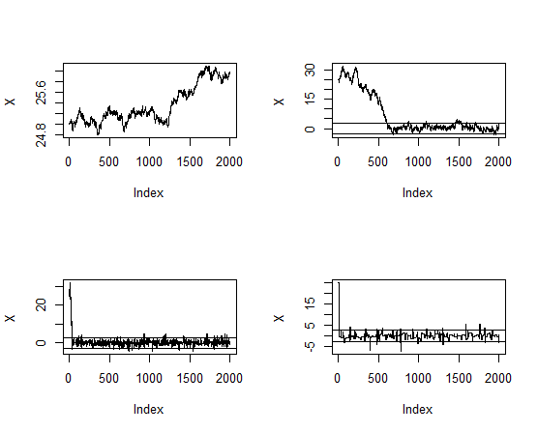
reference.line <- qt(c(.025, .975), df=n)
rw <- cbind(rwmh1$x, rwmh2$x, rwmh3$x, rwmh4$x)
for (j in 1:4) {
plot(rw[,j], type="l",
ylab="X", ylim=range(rw[,j]))
abline(h=reference.line)
}

Slide 4
Investment model
b <- .2 #actual value of beta
w <- .25 #width of the uniform support set
m <- 5000 #length of the chain
burn <- 1000 #burn-in time
days <- 250
x <- numeric(m) #the chain
# generate the observed frequencies of winners
# to simulate these values we use beta=0.2
i <- sample(1:5, size=days, replace=TRUE,
prob=c(1, 1-b, 1-2*b, 2*b, b))
win <- tabulate(i)
win ## [1] 75 78 54 26 17

Slide 5
probs <- function(y, win) {
# computes the target density
if (y < 0 || y >= 0.5)
return (0)
return((1/3)^win[1] *
((1-y)/3)^win[2] * ((1-2*y)/3)^win[3] *
((2*y)/3)^win[4] * (y/3)^win[5])
}
u <- runif(m) #for accept/reject step
v <- runif(m, -w, w) #proposal distribution
x[1] <- .25
for (i in 2:m) {
y <- x[i-1] + v[i]
if (u[i] <= probs(y, win) / probs(x[i-1], win))
x[i] <- y else
x[i] <- x[i-1]
}
win ##[1] 75 78 54 26 17
win/days ## [1] 0.300 0.312 0.216 0.104 0.068
c(1, 1-b, 1-2*b, 2*b, b)/3 ## [1] 0.33333333 0.26666667 0.20000000 0.13333333 0.06666667
xb <- x[(burn+1):m]
mean(xb) ## [1] 0.1689403

Slide 6
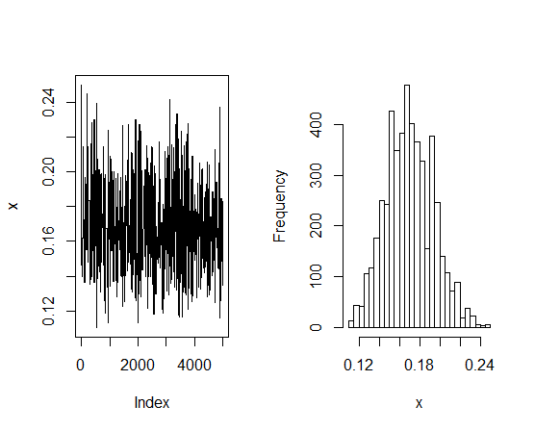

Slide 7
Example: Duodenal ulcer clinical trial data*
Placebo 400mg C 800 mg C 1600mg C
Week1 29 29 25 39
Week2 50 73 69 90
Week3 69 113 120 145

Slide 8
##search for a prior
##build an objective function
obj.fun<-function(parm)
{a<-parm[1]
b<-parm[2]
(pbeta(0.5,a,b)-0.75)^2+(pbeta(0.95,a,b)-0.85)^2}
##to minimize the objective function
outc<-optim(c(3,3),obj.fun)
outc
$par
[1] 0.06211388 0.18292668

Slide 9
##check the median and 95th percentile of this prior
pbeta(0.5,0.06211388,0.18292668)
#[1] 0.7499842
pbeta(0.95,0.06211388,0.18292668)
#[1] 0.8500024
a1<-120.0621
b1<-45.18293
##direct simulation
bayes1.betabin<-rbeta(10000,a1,b1)
quantile(bayes1.betabin,c(0.05,0.25,0.5,0.75,0.95))
5% 25% 50% 75% 95%
0.6682892 0.7041069 0.7280986 0.7505053 0.7821475

Slide 10
##MC simulation
library(MCMCpack)
bayes2.betabin<-MCbinomialbeta(120,165,a1,b1,mc=10000)
quantile(bayes2.betabin,c(0.05,0.25,0.5,0.75,0.95))
5% 25% 50% 75% 95%
0.6862353 0.7107756 0.7277076 0.7438726 0.7672826
summary(bayes2.betabin)
Iterations = 1:10000
Thinning interval = 1
Number of chains = 1
Sample size per chain = 10000
1. Empirical mean and standard deviation for each variable,
plus standard error of the mean:
Mean SD Naive SE Time-series SE
0.7271366 0.0245655 0.0002457 0.0002457

Slide 11
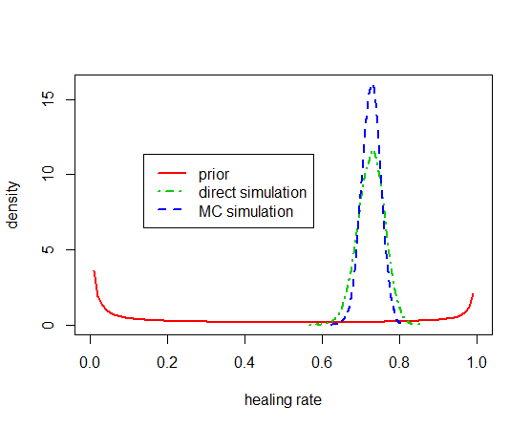
##plot the prior and posterior together
p1<-seq(0,1,0.01)
##plot the beta density
plot(p1,dbeta(p1,0.06211388 ,0.18292668),lwd=2,type="l",
xlab="healing rate",ylab="density",col=2,ylim=c(0,16))
lines(density(bayes1.betabin),lty=4,lwd=2,col=3)
lines(density(bayes2.betabin),lty=8,lwd=2,col=4)
legend(locator(1),c("prior","direct simulation",
"MC simulation"),col=c(2,3,4),
lwd=2,lty=c(1,4,8))

Slide 12
*: VA Study Group (1967). Veterans administration cooperative study group on antihypertensive agents: Effects on treatment on morbidity in hypertension: Results in patients with diastolic blood pressures averaging 115 through 129 mm hg. Journal of the American Medical Association 202(11), 1028-1034.

